Slide 1

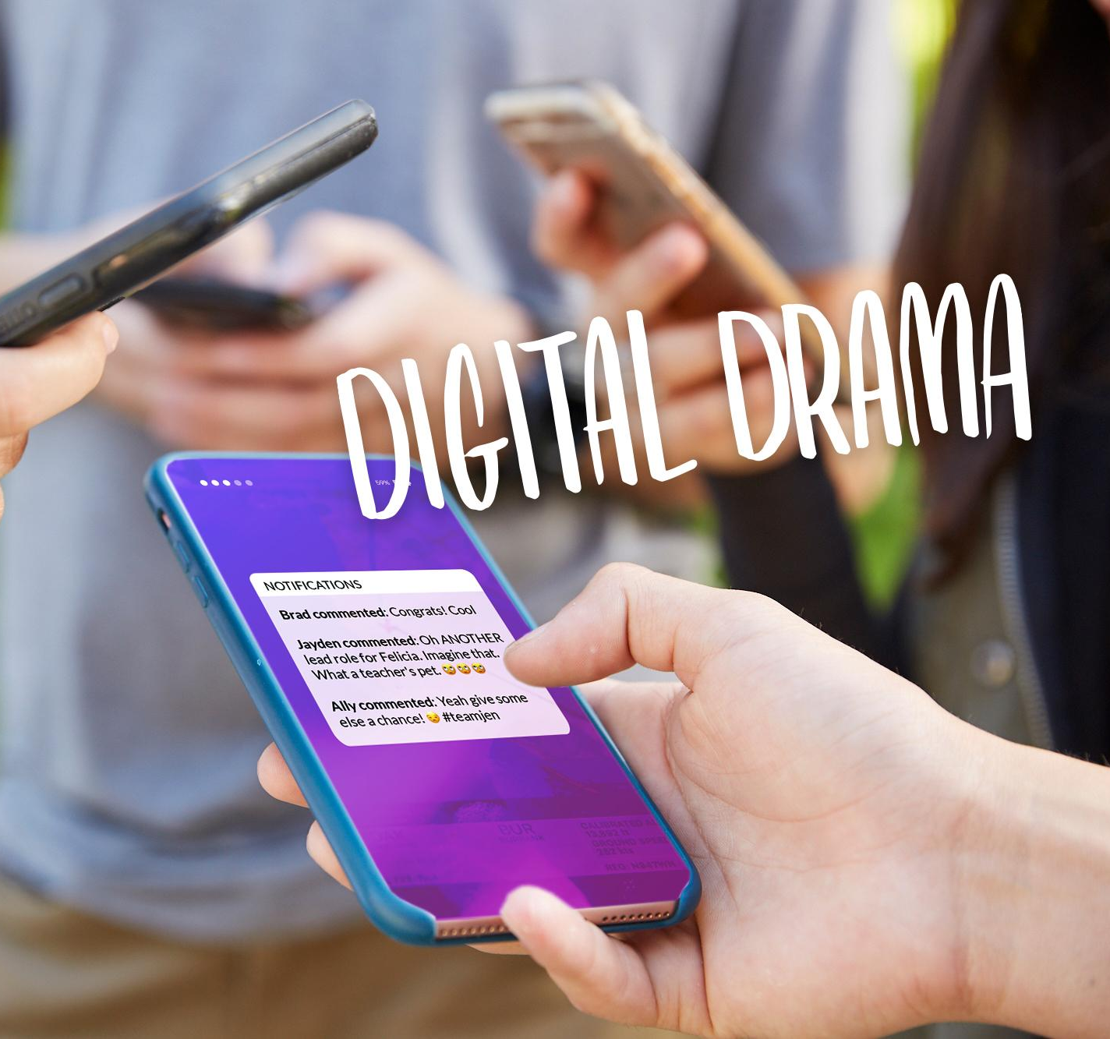
DIGITAL CITIZENSHIP | GRADE 6
Digital Drama Unplugged

Slide 2

Essential Question
How can we de-escalate digital drama so
it doesn't go too far?

Slide 3

Learning Objectives
l
Reflect on how easily drama can escalate online.
Identify de-escalation strategies for dealing with digital drama.
Reflect on how digital drama can affect not only oneself but also those around us.
2
3

Slide 4
Group-Discussion Norms
Respect others' viewpoints.
Don't interrupt.
Assume positive intent.
Disagree respectfully.
Notes:
This lesson involves students sharing their opinions on and ideas about scenarios, and there aren't necessarily right or wrong answers. Before opening up the discussion, it is recommended that teachers establish or review basic norms for discussion. Example norms could include

Slide 5

WARM UP: THINK, PAIR, SHARE
How does drama—emotional conflict between people—happen online? Can you think of any examples?
Directions:
Take a moment to think silently about this question.
The teacher will indicate when it's time to share out with a partner.
Notes:
Project Slide 5 and ask: Using this last example, how does drama -- emotional conflict between people -- happen online? Can you think of any examples? Take turns sharing with your partner.

Slide 6


KEY VOCABULARY
Digital drama
When people use devices, apps, or websites to start
or further a conflict between people
Notes:
Thank students for sharing examples and project Slide 6. Explain that digital drama is when people use devices, apps, or websites to start or further a conflict. Digital drama can be different from in-person drama for a number of reasons:
It can reach a big audience and reach them immediately.
It can include images or videos that get people's attention.
It can involve people posting things anonymously.

Slide 7

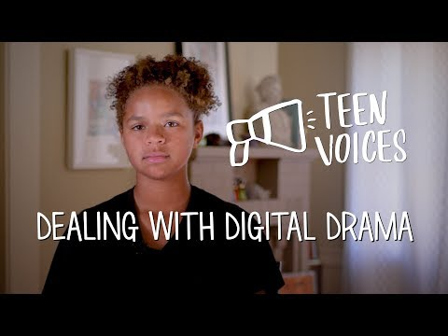
WATCH + DISCUSS
Discuss:
Why does digital drama happen?
What are some ways to deal with digital drama?
How can you get out of a digital drama situation?
To watch this video on the Common Sense Education site, click here.
Notes:
Show the Teen Voices: Dealing with Digital Drama video on Slide 7 and invite students to share out their responses to the two discussion questions. Prompt them to refer to specific lines from the video to support their responses.
Finish this discussion with posing the last bulleted question. Probing for student thoughts and ideas.

Slide 8

Directions
ACTIVITY: TAKING THE LEAD
In your group, each person will take on the viewpoint of a different person from the scenario. Write down the person you're taking the perspective of. Then, based on that perspective, complete the columns in the table. When you're done, each person will share out.
Roles:
Felicia
Jen
Jayden
Mr. Adler
Ally

Slide 9
KEY VOCABULARY
De-escalate
To lessen the intensity or anger in a conflict
Notes:
One thing that might have been helpful in this situation would be for someone to have de-escalated it. De-escalate means to lessen the intensity or anger in a conflict. Prompt students to consider this idea as they complete the Reflection Questions on the handout.

Slide 10
Ways to De-escalate
[Capture student responses here.]

Slide 11


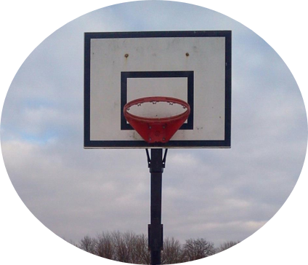


Scenario
ACTIVITY: ACT-IT-OUT
Middle
metronews.com
Mike B. @mikeyb25 • 1d
What about the rest
of us? 🤷
3:30 PM • 14 Jan 19
Dee @delilah40 • 3h
Teachers pets smh
Brian C. @shootsnscores1 • 1h
Big Gains for
CS Middle
metronews.com
Always jumping in front of the camera. #notsayinganynames
2
An online newspaper wrote a story about the success of the local middle school and used photos of students.
A student who wasn't pictured posted the article on social media with a negative comment.
Other students followed up with similar negative comments.

Slide 12
Directions
ACTIVITY: ACT-IT-OUT
Each person chooses a role to act out from the scenario (Mike B., Dee, Brian C., and a student from the photo).
Take a moment to think about your role and what that person might be thinking and feeling based on the scenario.
Decide on what you could say next to be true to your feelings but also to de-escalate the situation.
Do a whip-around, where each person shares what they could say.

Slide 13
If you have concerns about digital drama, relationships and/or bullying, please talk to a…
Parent or Guardian
Trusted adult
School Counselor
School Nurse
Teacher
Faith based leader
Health Clinic
Health care provider

Slide 14
Exit Ticket
Thinking about what we’ve talked about and the video…
What are some ways to get out of/avoid digital drama?

Slide 15
